Slide 1




University Institute of Engineering
Department of Computer Science & Engineering
COMPUTER ORGANIZATION & ARCHITECTURE
(23CST-204/23ITT-204)
ER. SHIKHA ATWAL
E11186
ASSISTANT PROFESSOR
BE-CSE

Slide 2
INTERCONNECTION NETWORKS
In parallel computing, Interconnection networks are very crucial for efficient communication among all processors within a similar system.
There are two main approaches for interconnecting these processors: static interconnection network and Dynamic interconnection network.
High-speed represents a single processor or memory module or even a group of processors.
High-speed computer Networks aim to provide fast and efficient performance (communication) among the nodes.
The infrastructure supports high bandwidth and low latency.

Slide 3
There are two types of Interconnection Network
Static Interconnection Network
Dynamic Interconnection Network
Static Interconnection Network
Static interconnection networks are fixed.
In a unidirectional static interconnection network, connections between nodes allow communication to occur in only one direction. So, the data can be transmitted from one node to another node but not in the reverse direction. However, in a bidirectional static interconnection network, the connection between nodes allows communication to occur in both directions.
The choice between both connections depends on the specific requirements of the parallel computing system.

Slide 4
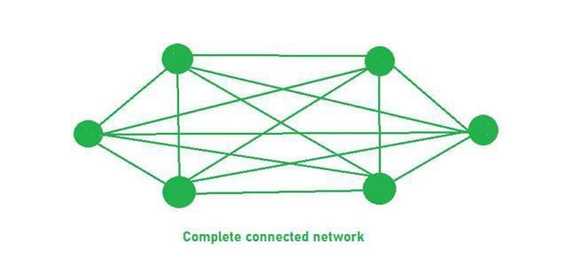
There are also two types of Static Interconnection Network
Completely/Fully Connected Network
Connectivity: Here each node connected to every other node in the system, means that there is direct connection between any pair of nodes.
Bandwidth and Latency: So here is the highest degree of connectivity. Advantages of fully connected network are low latency and high bandwidth.
Cost and Complexity: As the number of wires require more here so the it is expensive and it is much complex also

Slide 5
Data Transmission: Since there are direct connections between processors, data can be transmitted quickly and efficiently.
Number of Links: Number of links are required here is n(n-1)/2. Here n = 6, so total links will be 15 and each node link with (n-1) = (6-1) = 5 another nodes.

Slide 6
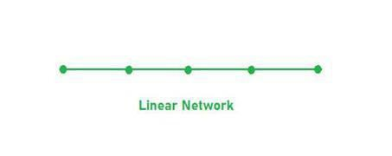
b) Limited Connection Network
It is also known as partial network, each node is connected by a subset of other nodes. It offers advantages such as reduced cost and complexity, optimized communication pattern and improved scalability. But they might introduce limitations in terms of bandwidth and fault tolerance compared to Completely or Fully connected network.
Examples: Ring Network, Tree Network, Linear array Network, Mesh Network, Hypercube Network
Linear Network: In a liner network every system is connected linearly or in single row fashion where if one system fails every system afterwards will stops working.

Slide 7
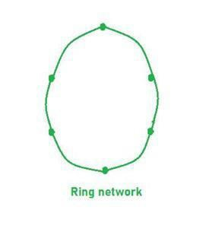
Ring Network: There is no major difference between linear and ring network only the difference between linear and ring is that the last node is connected to first node in Ring Network.
Three cube Network: A “Three Cube Network” typically refers to a network topology used in computer networking and data center design. This topology involves three switches (or cubes) interconnected in a specific way to provide redundancy and fault tolerance.

Slide 8
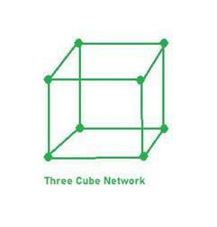
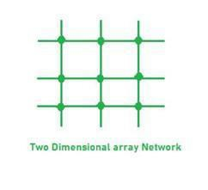
Two-Dimensional Network: A two-dimensional network, in the context of computer networking and parallel computing, typically refers to a network topology where devices or nodes are arranged in a grid-like fashion. This type of network structure is commonly used in various distributed computing environments for efficient communication between nodes.

Slide 9
Here are some key points regarding Limited connection network,
Connectivity: Here we notice lower number of connections per node compared to Completely or Fully connected network.
Communication Paths: Communication between some nodes may be routed through other node in this network.
Scalability: It offers good scalability as the number of connections per node typically grows.
Cost and Complexity: Limited Connection Networks have lower cost and complexity.
Bandwidth and Latency: Limited Bandwidth compared to completely connected networks as there are limited number of connections.

Slide 10
Dynamic Interconnection Network
Unlike Static Interconnection Network, where connections are fixed between node, it enables the dynamic reconfiguration of connection to adapt to changing communication requirements. Some key points about Dynamic Interconnection Network:
Reconfiguration:
The network can dynamically change its configuration to adapt to different communication patterns or workloads. This allows the network to connect any two components as needed.
Optimizes communication paths.
Adapts to changes in workloads.
Supports fault recovery by rerouting around failed components.
Example: A multistage interconnection network (e.g., Clos network) can reconfigure to provide direct paths between active components.

Slide 11
2. Switching Mechanisms:
Refers to the methods used to transfer data through the network. Common mechanisms include:
Circuit Switching: Establishes a dedicated path for the entire communication.
Packet Switching: Divides messages into packets that are routed independently.
Wormhole Switching: Sends data in small "flits" (flow control digits) that are transmitted in a pipeline fashion.
Determines latency and throughput.
Impacts network performance and efficiency.
Example: Packet switching is commonly used in dynamic networks to support parallel communications.

Slide 12
3. Flexibility:
The ability to support various communication patterns and configurations without major hardware changes. Dynamic networks can handle:
Point-to-point communication.
Broadcast or multicast.
Data aggregation or reduction.
Makes the network suitable for a wide range of applications.
Reduces the need for application-specific hardware.
Example: A crossbar switch provides maximum flexibility by allowing any input to connect to any output.

Slide 13
4. Scalability:
The network can grow to support additional components (e.g., processors or memory modules) without significant performance degradation.
Supports future expansion of systems.
Ensures consistent performance as the system size increases.
Example: Fat-tree networks are scalable and often used in data centers to connect a large number of servers.

Slide 14
Fault Tolerance:
The network can detect and recover from failures in components (e.g., switches, links) by rerouting traffic or reconfiguring connections.
Increases system reliability.
Ensures continuous operation despite hardware failures.
Example: Dynamic networks use redundant paths to reroute data in case of link or node failures.

Slide 15
6. Communication Efficiency:
Refers to the network's ability to minimize delays and maximize bandwidth utilization for data transfer.
Reduces latency and improves overall system performance.
Prevents congestion and bottlenecks.
Example: Networks with low-diameter topologies, such as hypercube or torus, reduce the average number of hops for data transfer, enhancing efficiency.

Slide 16
Organizational Structure
Interconnection networks are composed of following three basic components −
Links − A link is a cable of one or more optical fibers or electrical wires with a connector at each end attached to a switch or network interface port. Through this, an analog signal is transmitted from one end, received at the other to obtain the original digital information stream.
Switches − A switch is composed of a set of input and output ports, an internal “cross- bar” connecting all input to all output, internal buffering, and control logic to affect the input-output connection at each point in time. Generally, the number of input ports is equal to the number of output ports.

Slide 17
Network Interfaces − The network interface behaves quite differently than switch nodes and may be connected via special links. The network interface formats the packets and constructs the routing and control information. It may have input and output buffering, compared to a switch. It may perform end-to-end error checking and flow control. Hence, its cost is influenced by its processing complexity, storage capacity, and number of ports.

Slide 18
Interconnection Network
Interconnection networks are composed of switching elements. Topology is the pattern to connect the individual switches to other elements, like processors, memories and other switches. A network allows exchange of data between processors in the parallel system.
Direct connection networks − Direct networks have point-to-point connections between neighboring nodes. These networks are static, which means that the point-to- point connections are fixed. Some examples of direct networks are rings, meshes and cubes.
Indirect connection networks − Indirect networks have no fixed neighbors. The communication topology can be changed dynamically based on the application demands.

Slide 19
Indirect networks can be subdivided into three parts: bus networks, multistage networks and crossbar switches.
Bus networks − A bus network is composed of a number of bit lines onto which a number of resources are attached. When busses use the same physical lines for data and addresses, the data and the address lines are time multiplexed. When there are multiple bus-masters attached to the bus, an arbiter is required.
Multistage networks − A multistage network consists of multiple stages of switches. It is composed of ‘axb’ switches which are connected using a particular interstage connection pattern (ISC). Small 2x2 switch elements are a common choice for many multistage networks. The number of stages determine the delay of the network. By choosing different interstage connection patterns, various types of multistage network can be created.

Slide 20
Crossbar switches − A crossbar switch contains a matrix of simple switch elements that can switch on and off to create or break a connection. Turning on a switch element in the matrix, a connection between a processor and a memory can be made. Crossbar switches are non-blocking, that is all communication permutations can be performed without blocking.

Slide 21
References
Reference Books:
J.P. Hayes, “Computer Architecture and Organization”, Third Edition.
Mano, M., “Computer System Architecture”, Third Edition, Prentice Hall.
Stallings, W., “Computer Organization and Architecture”, Eighth Edition, Pearson Education.
Text Books:
Carpinelli J.D,” Computer systems organization &Architecture”, Fourth Edition, Addison Wesley.
Patterson and Hennessy, “Computer Architecture”, Fifth Edition Morgaon Kauffman.

Slide 22
Other References:
http://cva.stanford.edu/classes/ee382c/ee482b/scribes01/lect04/ourlect_final.pdf
https://www.tutorialspoint.com/parallel_computer_architecture/parallel_computer_arc hitecture_interconnection_network_design.htm
Video Links:
https://youtu.be/kI546SzGbLM?si=JIJDKDoAsDEUqOCe
https://youtu.be/jGuRdQRyIvc?si=VrResuXABzF0LZyW

